Slide 1
OPEATING SYSTEMS
CSE 4300
Instructor:Mohammad Maifi Hasan Khan
Chapter 3
Memory Management

Slide 2

No Memory Abstraction
Three simple ways of organizing memory with an operating system and one user process.

Slide 3
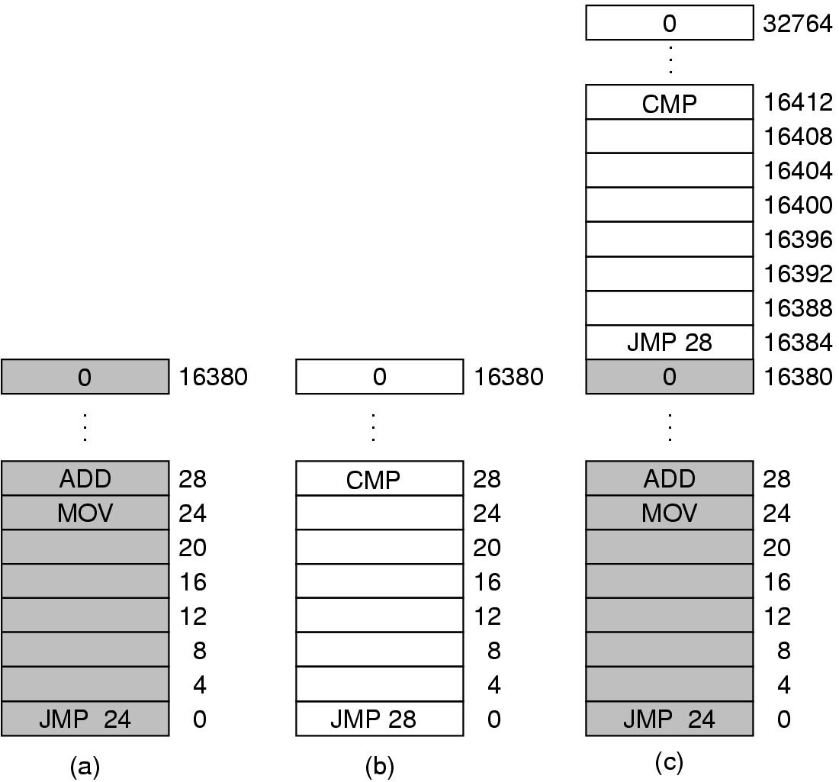
Multiple Programs Without Memory Abstraction
Illustration of the relocation problem.

Slide 4
Multiple Programs Without Memory Abstraction
One process can access another process’s memory regions
How to load and run multiple programs?
Illustration of the relocation problem.

Slide 5
Multiple Programs Without Memory Abstraction
One process can access another process’s memory regions
How to load and run multiple programs?
Solution: One possibility is static relocation
Illustration of the relocation problem.

Slide 6
Multiple Programs Without Memory Abstraction
One process can access another process’s memory regions
How to load and run multiple programs?
Solution: One possibility is static relocation
  Slow!
  Loader needs to know which are constants and which are memory addresses!
Illustration of the relocation problem.

Slide 7
Another possibility?

Slide 8
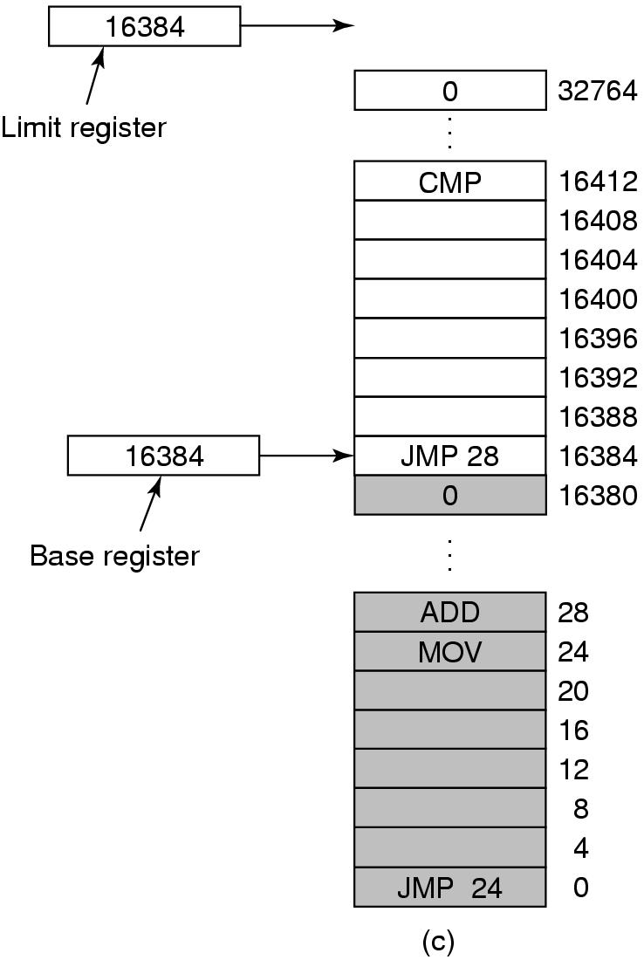
Base and Limit Registers
Base and limit registers can be used to give each process a separate address space.

Slide 9
Base and Limit Registers
Addition and Comparison for each memory reference! ☹
Base and limit registers can be used to give each process a separate address space.

Slide 10
Ok, now that we have a way to protect processes from messing up each other,
how do we fit all the processes in memory?

Slide 11
Ok, now that we have a way to protect processes from messing up each other,
how do we fit all the processes in memory?
Two possibilities:
(i) Swapping – bring the whole process in memory
(ii) Virtual memory – bring in partial process in memory of not enough space

Slide 12

Swapping (1)
Memory allocation changes as processes come into memory and leave it. The shaded regions are unused memory.

Slide 14
Swapping (1)
How do you deal with these memory holes?
Memory allocation changes as processes come into memory and leave it. The shaded regions are unused memory.

Slide 15
Swapping
How do you deal with these memory holes?
Memory Compaction!
Memory allocation changes as processes come into memory and leave it. The shaded regions are unused memory.

Slide 16

Swapping
Allocating space for growing data segment.
Allocating space for growing stack, growing data segment.

Slide 17
Swapping
What if there is not enough space for a process to grow?
Allocating space for growing data segment.
Allocating space for growing stack, growing data segment.

Slide 18
Swapping
What if there is not enough space for a process to grow?
Option 1: Move to a bigger hole if available
Option 2: Suspend until enough space becomes available
Option 3: Kill it!
Allocating space for growing data segment.
Allocating space for growing stack, growing data segment.

Slide 20

Memory Management with Bitmaps
A part of memory with five processes and three holes. The tick marks show the memory allocation units. The shaded regions (0 in the bitmap) are free.
The corresponding bitmap.
The same information as a list.

Slide 22
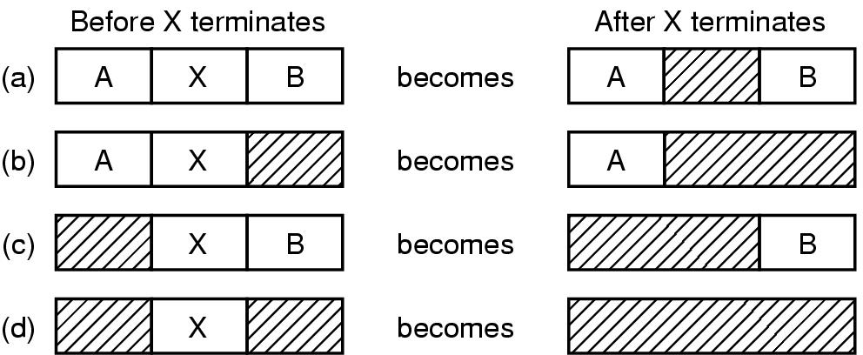
Memory Management with Linked Lists
Four neighbor combinations for the terminating process, X.

Slide 23
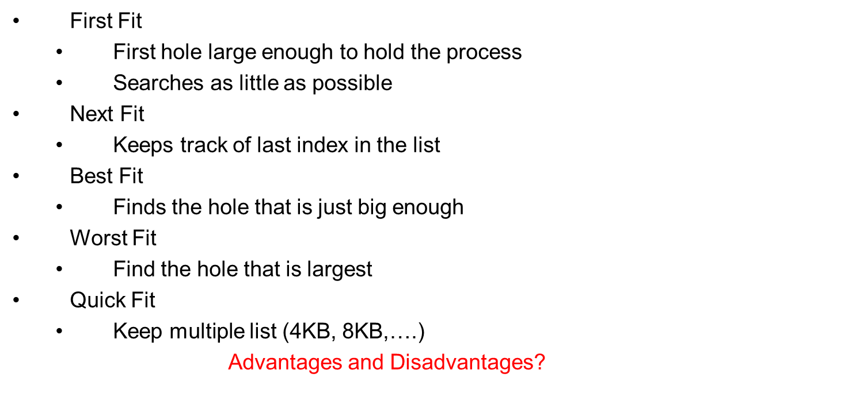
Memory Allocation Algorithm

Slide 25
Virtual Memory
Overlay
  Split programs into small pieces
  Initially, loads overlay manager, that is responsible for swapping overlay
  Programmer needs to define the overlays!

Slide 27

Virtual Memory – Paging (1)
The position and function of the MMU – shown as being a part of the CPU chip (it commonly is nowadays). Logically it could be a separate chip, was in years gone by.

Slide 29
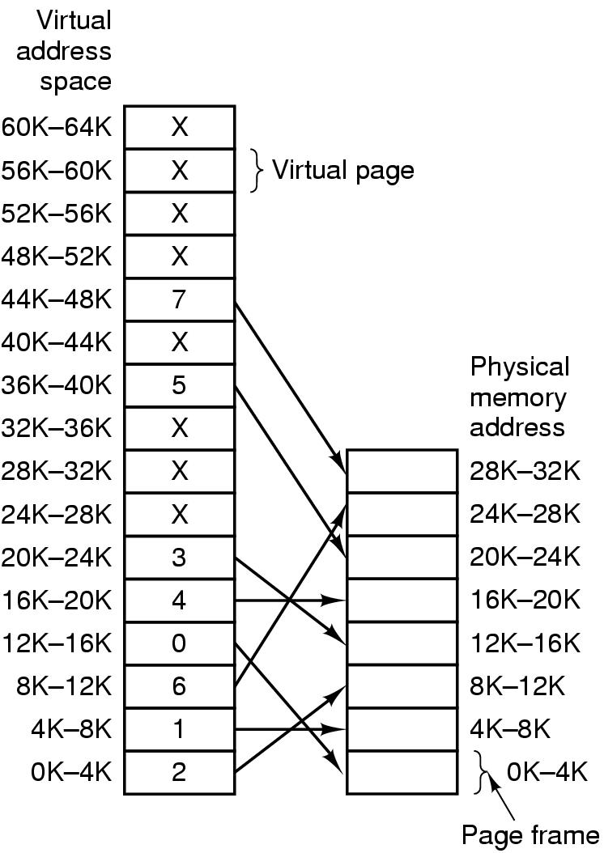
Paging (2)
MOV REG,0 > MOV REG, 8192
MOV REG,8192 > MOV REG, ?
24576
MOV REG 32780 > MOV REG, ?
Page Fault
Relation between virtual addresses and physical memory addresses given by page table.

Slide 31

Paging (3)
The internal operation of the MMU with 16 4-KB pages.

Slide 32
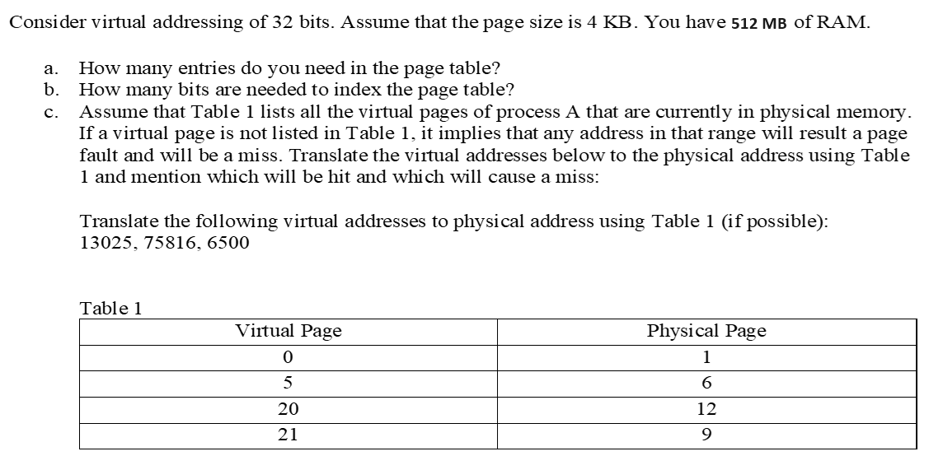
13025 = 0000 0000 0000 0000 0011 0010 1110 0001

Slide 33
2^32/2^12 = 2^20 entries
20 bits
13025 = 0000 0000 0000 0000 0011 0010 1110 0001 // VP = 3, Miss
75816 = 0000 0000 0000 0001 0010 1000 0010 1000 // VP = 18, Miss
6500 = 0000 0000 0000 0000 0001 1001 0110 0100 // VP = 1, Miss
Virtual address 21386 = 0000 0000 0000 0000 0101 0011 1000 1010 // VP = 5
Physical address = 00 0000 0000 0000 0110 0011 1000 1010 // 512 MB RAM -> 30 bit physical address

Slide 34

Structure of Page Table Entry
A typical page table entry.

Slide 35
Speeding Up Paging
Paging implementation issues:
The mapping from virtual address to physical address must be fast.
If the virtual address space is large, the page table will be large.

Slide 37
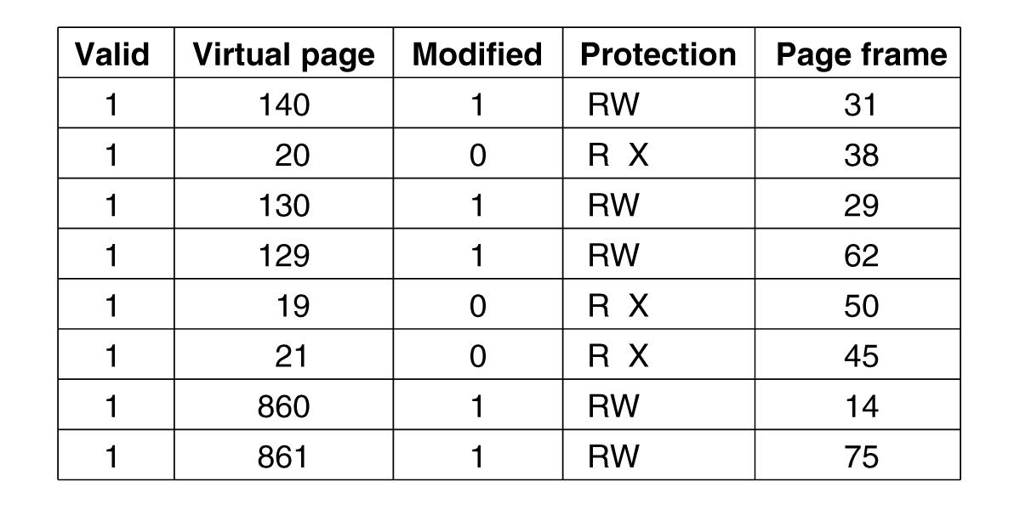
Translation Lookaside Buffers
Soft Miss
Hard Miss
A TLB to speed up paging.

Slide 39

Multilevel Page Tables
Address 4,206,596 (0x00403004)
PT1=1, PT2=2, offset=4
(a) A 32-bit address with two page table fields.
(b) Two-level page tables.

Slide 41
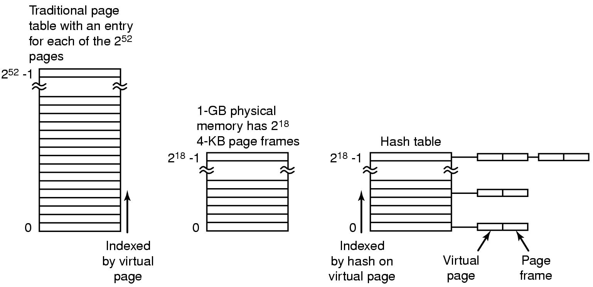
Inverted Page Tables
64 bit address, 4KBpages, 2^52 page table entries
If each entry 8 bytes, ?
Inverted: one entry per page frame
For 1 GB RAM, how many entries?
(process, virtual page) pair
Need to search the whole table for each memory reference!
Hash table: Hashed on virtual address
Comparison of a traditional page table
with an inverted page table.

Slide 43
Page Replacement
Page Fault:
  Need to make room in memory
  Implies – some page needs to be sent back to disk
  What about dirty pages?
  What pages to remove?

Slide 44
Page Replacement Algorithms
Optimal page replacement algorithm
First-In, First-Out page replacement
Not recently used page replacement
Second chance page replacement
Clock page replacement
Least recently used page replacement
Working set page replacement
WSClock page replacement

Slide 45
Page Replacement Algorithms
Optimal page replacement algorithm
  ?

Slide 46
Page Replacement Algorithms
FIFO
  ?

Slide 47
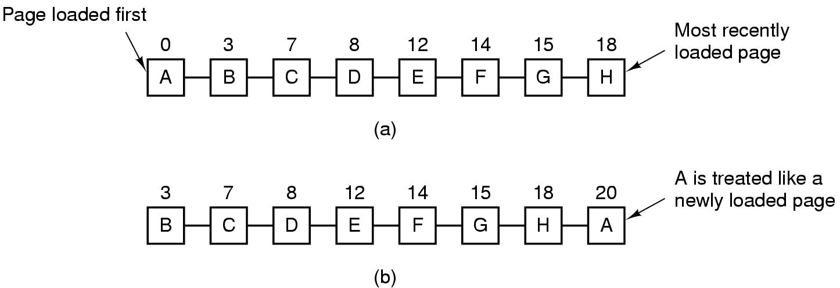
Second Chance Algorithm
Operation of second chance.
(a) Pages sorted in FIFO order.
(b) Page list if a page fault occurs at time 20 and A has its R bit set. The numbers above the pages are their load times.

Slide 48
Second Chance Algorithm
Constantly moving around pages on list
Operation of second chance.
(a) Pages sorted in FIFO order.
(b) Page list if a page fault occurs at time 20 and A has its R bit set. The numbers above the pages are their load times.

Slide 49
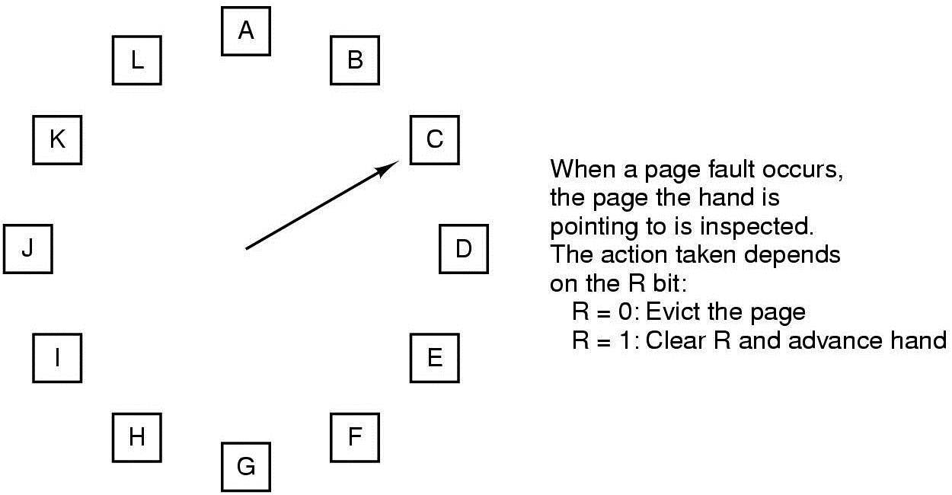
The Clock Page Replacement Algorithm
The clock page replacement algorithm.

Slide 50
NRU Page Replacement Algorithms
Not recently used (NRU) page replacement
  R bit - referenced
  M bit – modified
  R bit cleared periodically
  M bit never cleared
  Class 0: R=0,M=0
  Class 1: R=0, M=1
  Class 2: R=1, M =0
  Class3: R=1, M=1
  Replace the page from the lowest class

Slide 51
LRU Page Replacement Algorithm (Hardware) – Solution 1
Least recently used
Maintain a hardware counter C, automatically incremented after each instruction
Each page table entry also has a counter variable
For each memory reference, update the counter for the corresponding page table entry
After a page fault, OS examines all the counters and picks the one with the lowest counter value

Slide 52
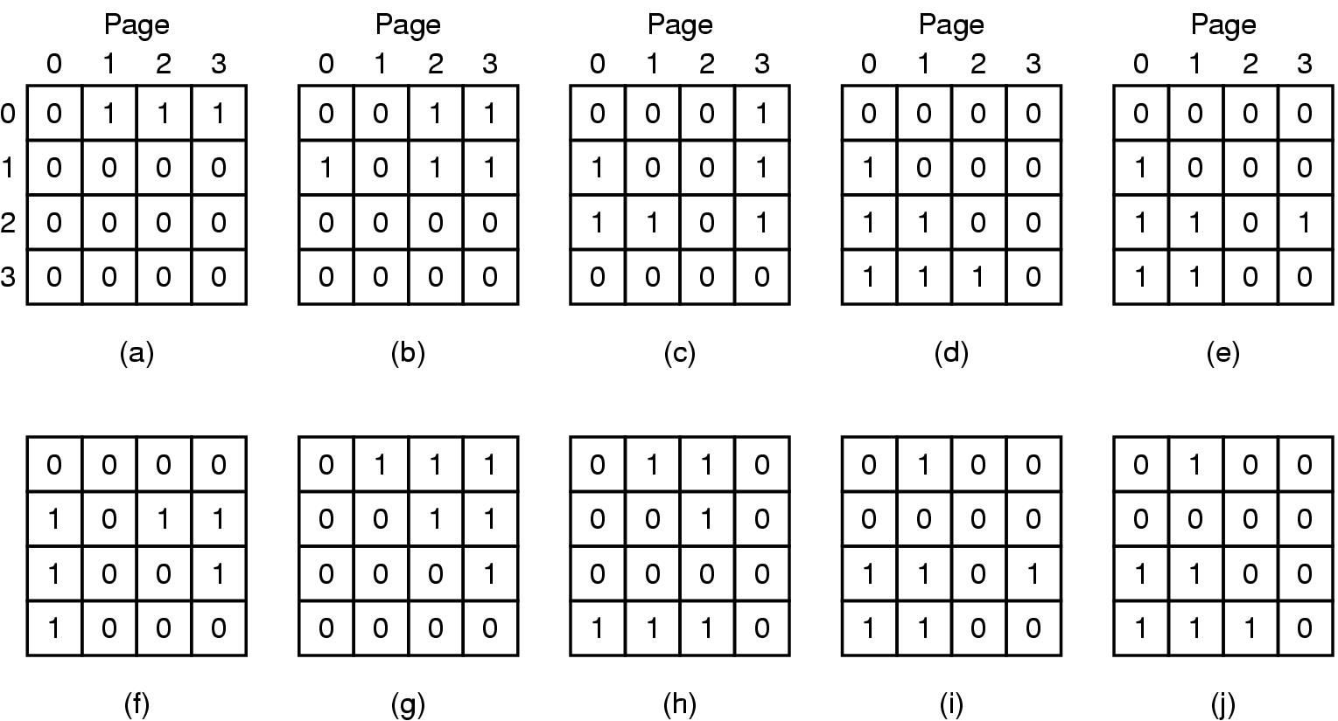
LRU Page Replacement Algorithm (Hardware) – Solution 2
LRU using a matrix when pages are referenced in the order 0, 1, 2, 3, 2, 1, 0, 3, 2, 3.

Slide 53
LRU Page Replacement Algorithm (Hardware) – Solution 2
Hard to implement in hardware ☹
LRU using a matrix when pages are referenced in the order 0, 1, 2, 3, 2, 1, 0, 3, 2, 3.

Slide 54
Simulating LRU in Software

Slide 55
Not Frequently Used (NFU)
Software counter for each page table entry
At each clock interrupt, OS scans all the pages and add the R bit to the counter
At page fault, choose the page with the lowest counter value

Slide 56
Not Frequently Used (NFU)
Software counter for each page table entry
At each clock interrupt, OS scans all the pages and add the R bit to the counter
At page fault, choose the page with the lowest counter value
  Never forgets anything ☹

Slide 57
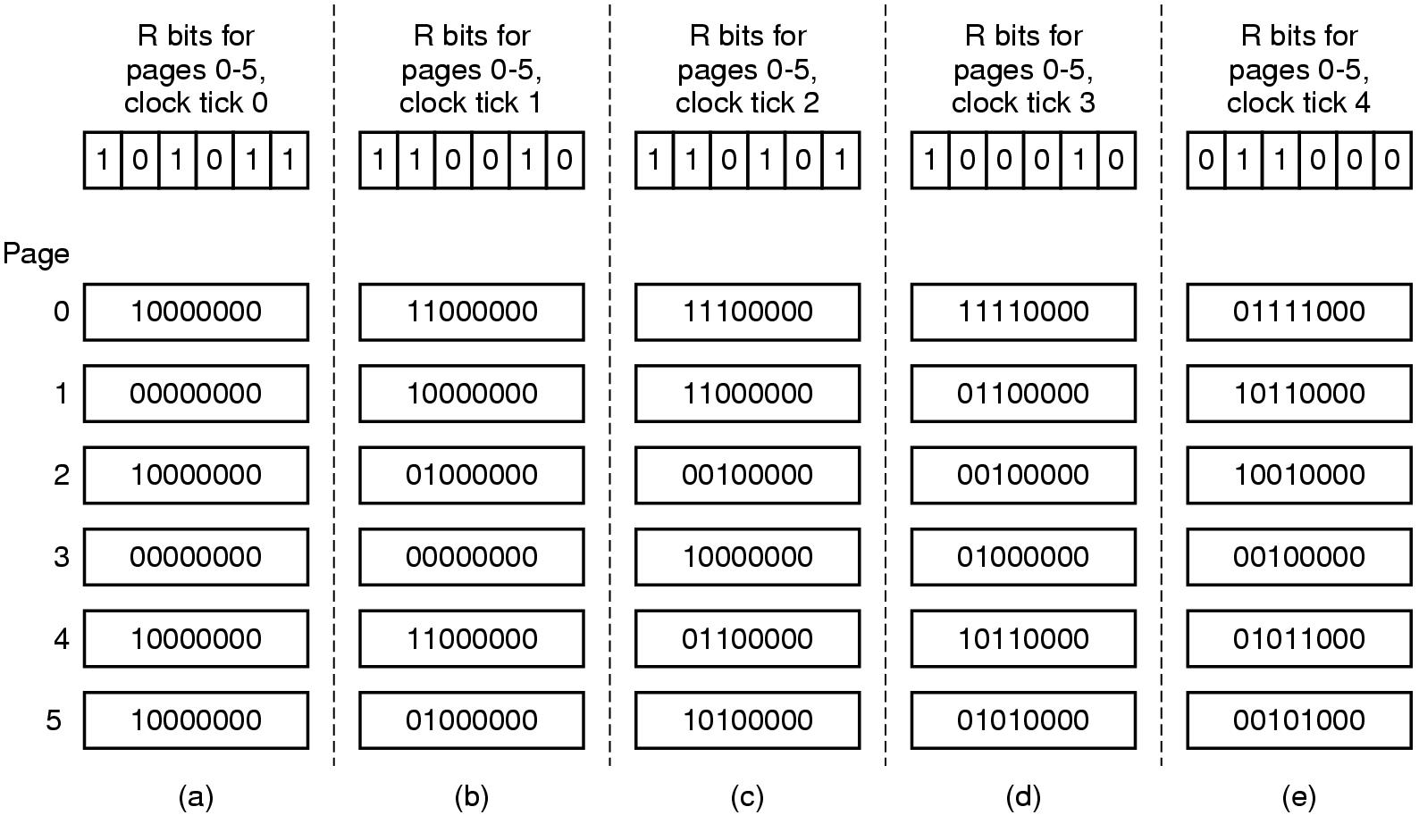
Small Modification to NFU ->
Simulating LRU in Software
The aging algorithm simulates LRU in software. Shown are six pages for five clock ticks. The five clock ticks are represented by (a) to (e).

Slide 58
Simulating LRU in Software
Limitations?
8 bits limits the horizon
Within a single tick, no way of knowing which was referenced earlier
  A single tick can be few milliseconds

Slide 59
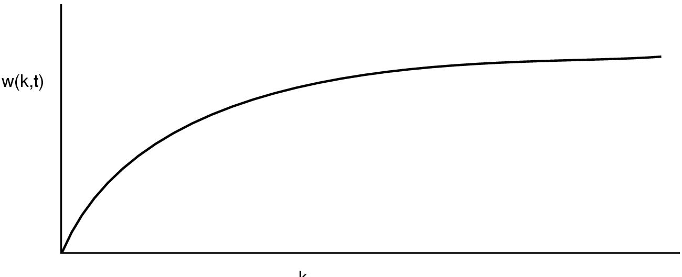
Working Set Page Replacement (1)
Demand Paging: Fetch page if page fault occurs
Thrashing: Page fault every few instructions
Can we exploit locality of reference?
Prepaging?
The working set is the set of pages used by the k most recent memory references. The function w(k, t) is the size of the working set at time t.

Slide 60
The WSClock Page Replacement Algorithm (1)
Need to keep track of working set!
  Set of pages referenced in the last k memory references!
    Expensive to implement!
Keep track for last t sec

Slide 61
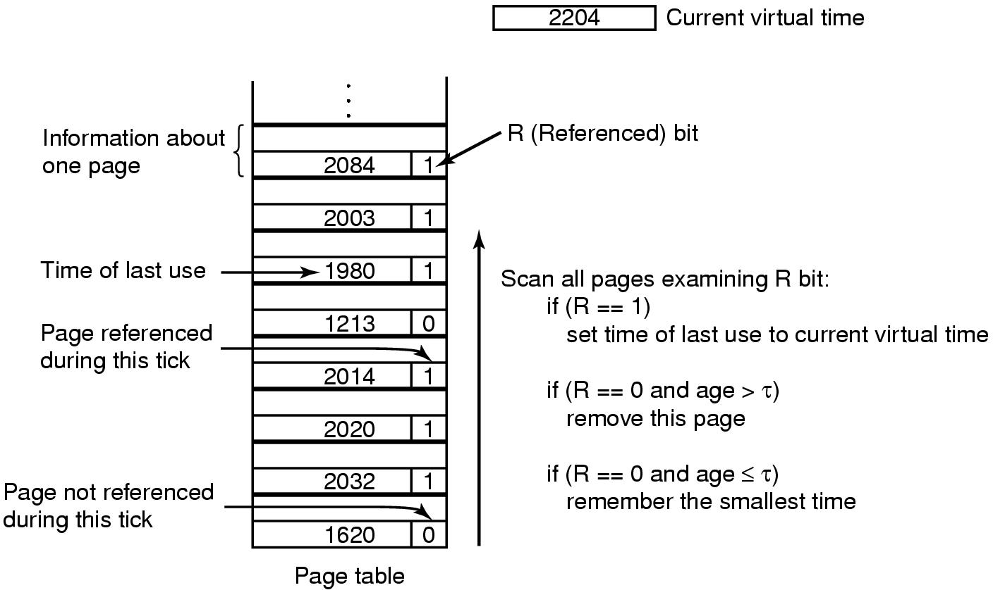
Working Set Page Replacement (2)
The working set algorithm.

Slide 62
Working Set Page Replacement (2)
Need to scan entire table at a page fault!
The working set algorithm.

Slide 63
The WSClock Page Replacement Algorithm (1)
WorkingSet Clock Algorithm
If old page and M=0, claim
If old page and M=1, schedule write to avoid context switch
When the hand comes all the way around to its starting point there are
two cases to consider:
At least one write has been scheduled.
  Keep scanning to find a clean page
No writes have been scheduled.
  Claim any clean page and use it

Slide 64
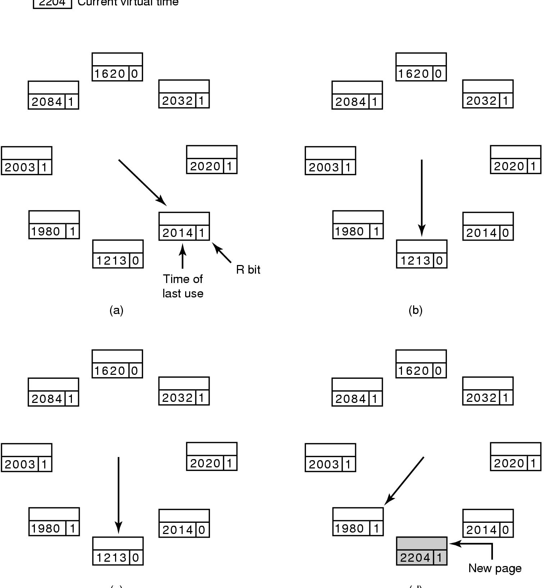
The WSClock Page Replacement Algorithm (2)
2204
Current virtual time
(c)
(d)
Operation of the WSClock algorithm. (a) and (b) give an example of what happens when R = 1.

Slide 65
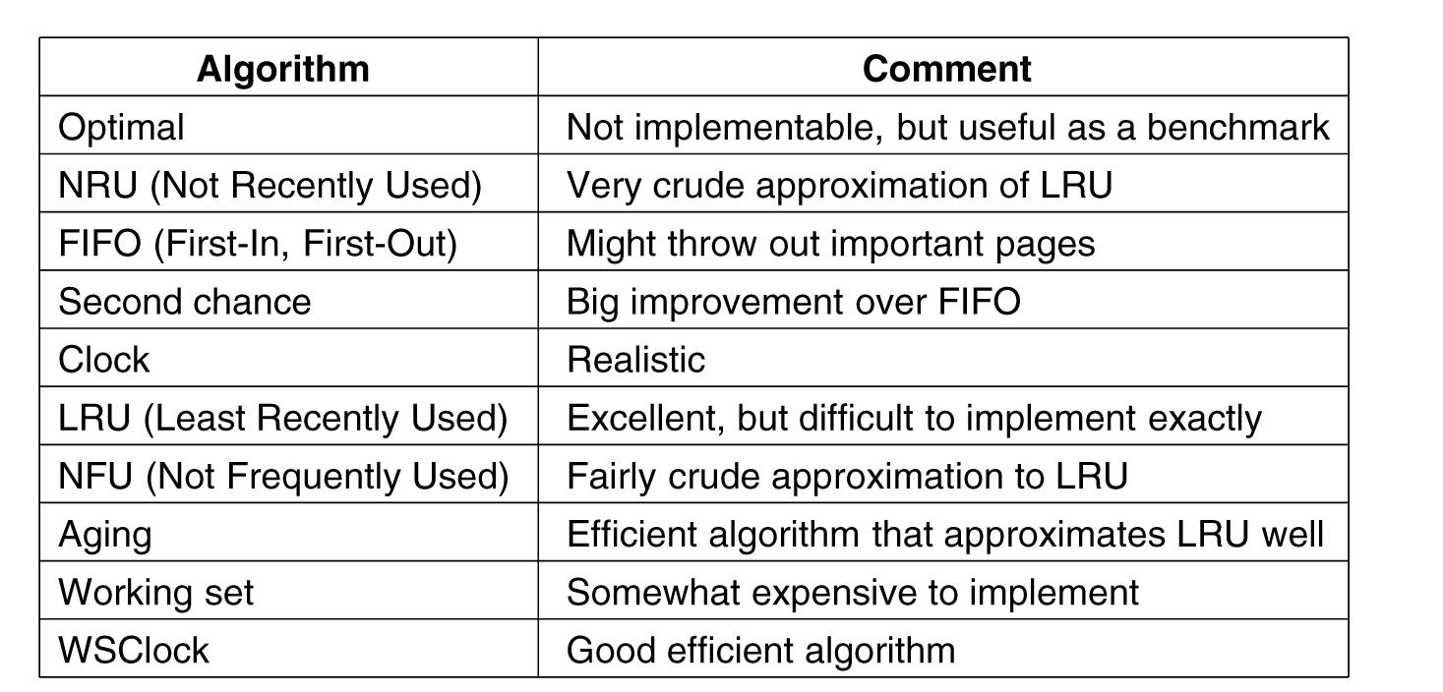
Summary of Page Replacement Algorithms
Page replacement algorithms discussed in the text.

Slide 66
Design Issues for Paging System

Slide 68
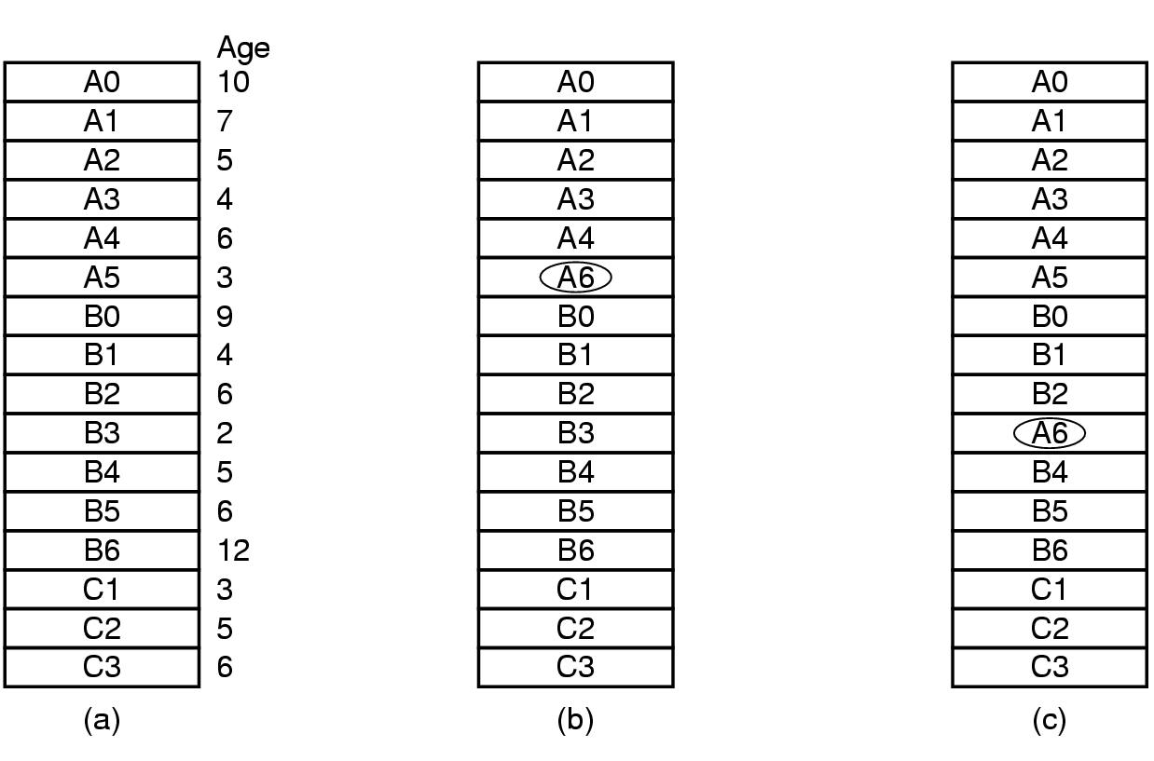
Local versus Global Allocation Policies (1)
Figure 3-23. Local versus global page replacement.
(a) Original configuration. (b) Local page replacement.
(c) Global page replacement.

Slide 70
Global is better, if working set size can vary over the lifetime of the process.
An algorithm is needed to decide how to allocate pages/process
  Can allocate equal share
  Can allocate proportional to the process size
  Can allocate based on page fault frequency (PPF)

Slide 72
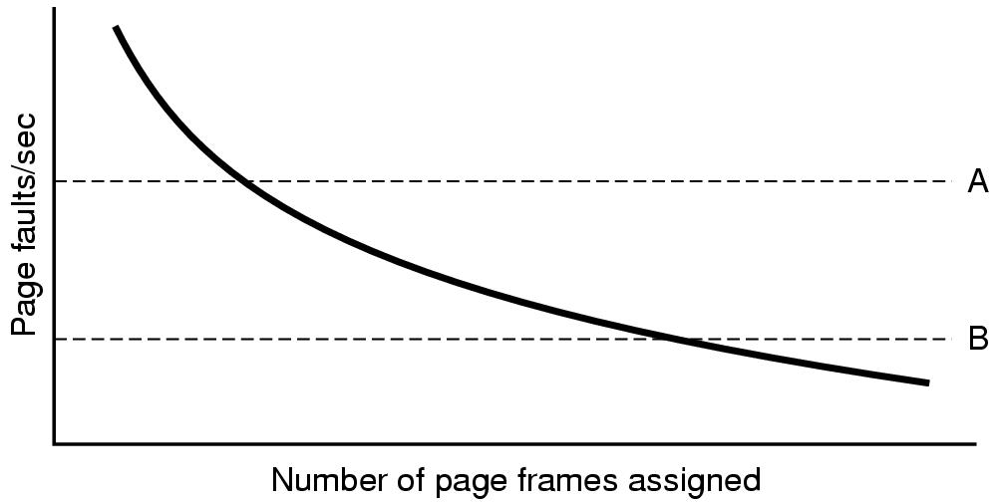
Local versus Global Allocation Policies (2)
Page fault rate as a function of
the number of page frames assigned.
Some algorithm can work with both local and global policy (e.g., LRU, FIFO)
Some algorithms only make sense with Local policy (?)

Slide 73
Load Control
Some process needs more pages, but none needs less !
Solution: Swap out process to disk
Need to consider characteristics of job!
Degree of multiprogramming?

Slide 74
Page Size
On average, half of the last page is empty (wasted)!
Smaller page: less wasted space!
But, large page table, long loading time!
s= avg process size
p = page size
e = page entry size
Overhead= (s/p)*e + p/2
p=sqrt(2se)

Slide 75
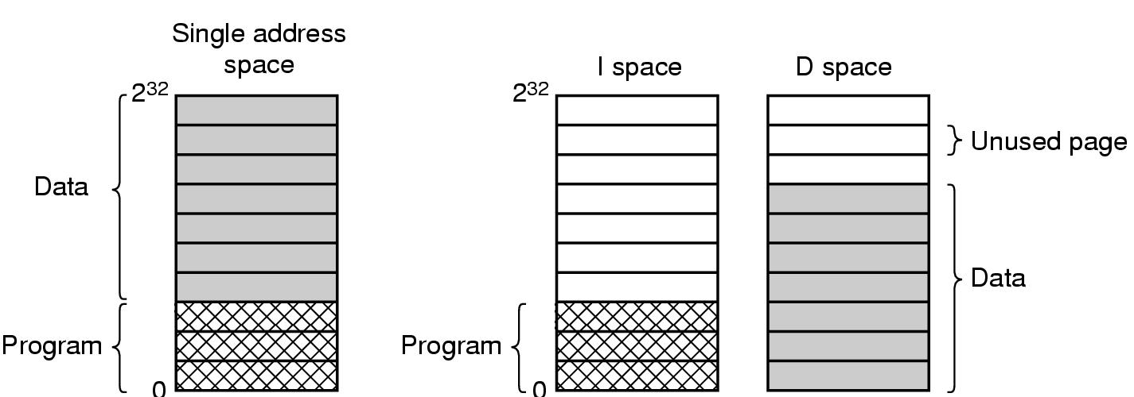
Separate Instruction and Data Spaces
Separate page table
Double the available space
(a) One address space.
(b) Separate I and D spaces.

Slide 76
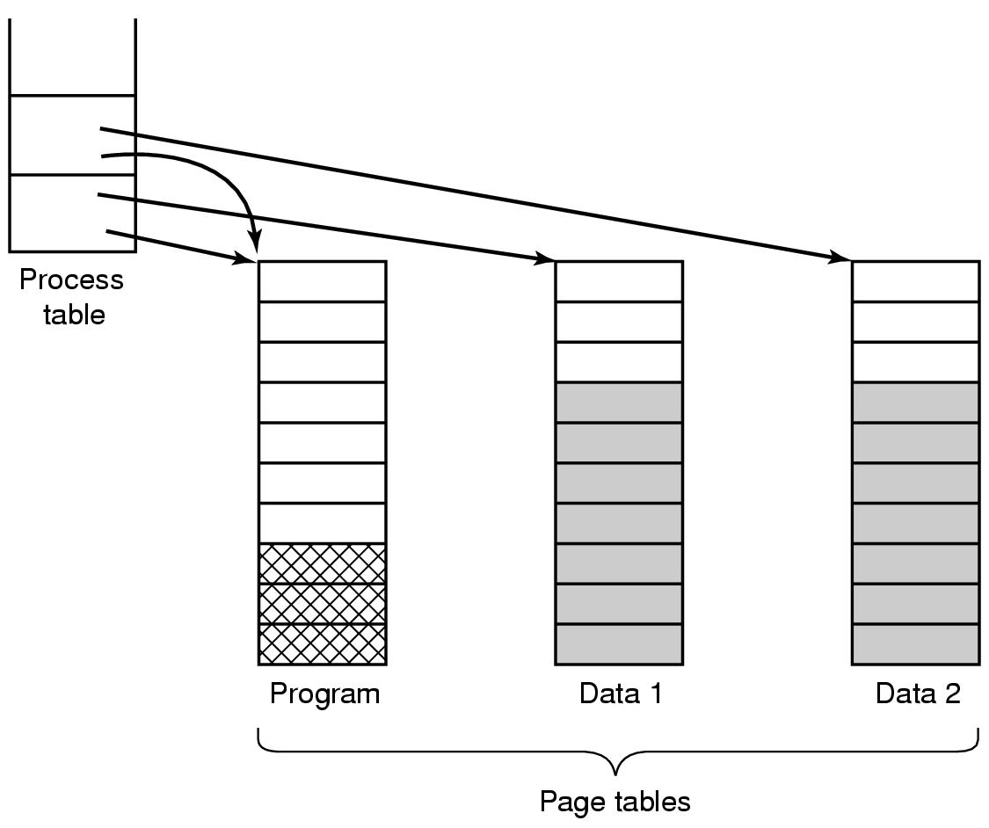
Shared Pages
Copy on write concept
- Initially READ only
- On write, make individual copies and mark READ-WRITE
Two processes sharing the same program sharing its page table.

Slide 77
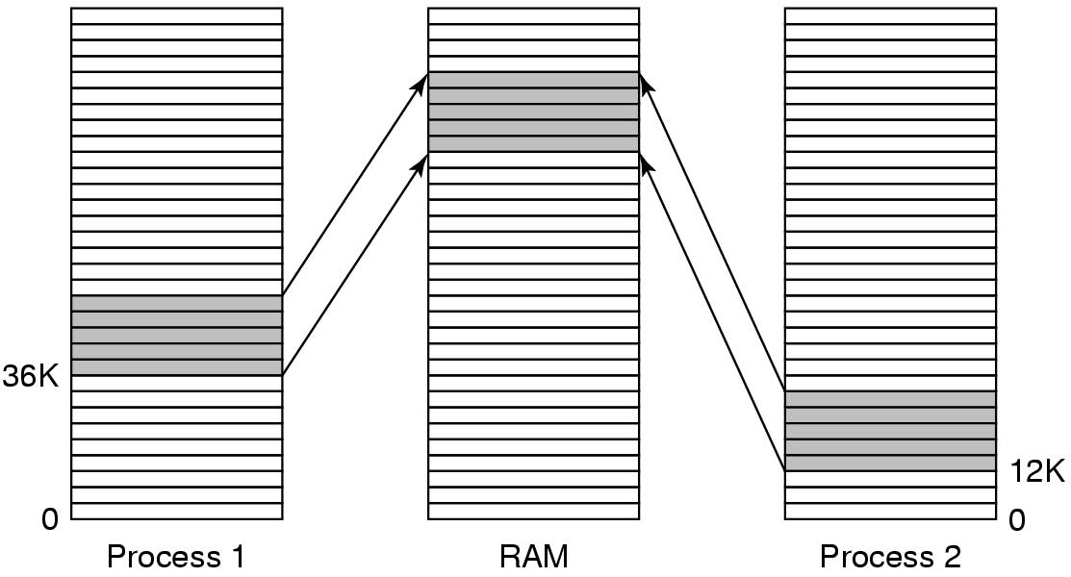
Shared Libraries
Position-independent code
Extra benefit: Easy to fix bug
Example: DLL in Windows
A shared library being used by two processes.

Slide 78
Mapped Files
Used for I/O
  Map I/O read/write to address space
  Will study later in the course!

Slide 79
Cleaning Policy
Paging Daemon
  Periodically checks available memory
  If too low, pre-select pages to evict
  If dirty, schedule write
  If a selected page is required before it is reused, just move it back from available pool of free page frame
  Two-handed Clock:
  First hand used by the cleaning daemon. Second hand is used by the page replacement algorithm

Slide 80
Implementation Issues

Slide 81
Page Fault Handling (1)
The hardware traps to the kernel, saving the program counter on the stack.
An assembly code routine is started to save the general registers and other volatile information.
The operating system discovers that a page fault has occurred, and tries to discover which virtual page is needed.
Once the virtual address that caused the fault is known, the system checks to see if this address is valid and the protection consistent with the access

Slide 82
Page Fault Handling (2)
If the page frame selected is dirty, the page is scheduled for transfer to the disk, and a context switch takes place.
When page frame is clean, operating system looks up the disk address where the needed page is, schedules a disk operation to bring it in.
When disk interrupt indicates page has arrived, page tables updated to reflect position, frame marked as being in normal state.

Slide 83
Page Fault Handling (3)
Faulting instruction backed up to state it had when it began and program counter reset to point to that instruction.
Faulting process scheduled, operating system returns to the (assembly language) routine that called it.
This routine reloads registers and other state information and returns to user space to continue execution, as if no fault had occurred.

Slide 84
The Issue of Instruction Backup?
  From what address to restart the execution?
Locking Pages in Memory?
  I/O and page replacement algorithm can interfere
  Pinning: locking a page in memory

Slide 85
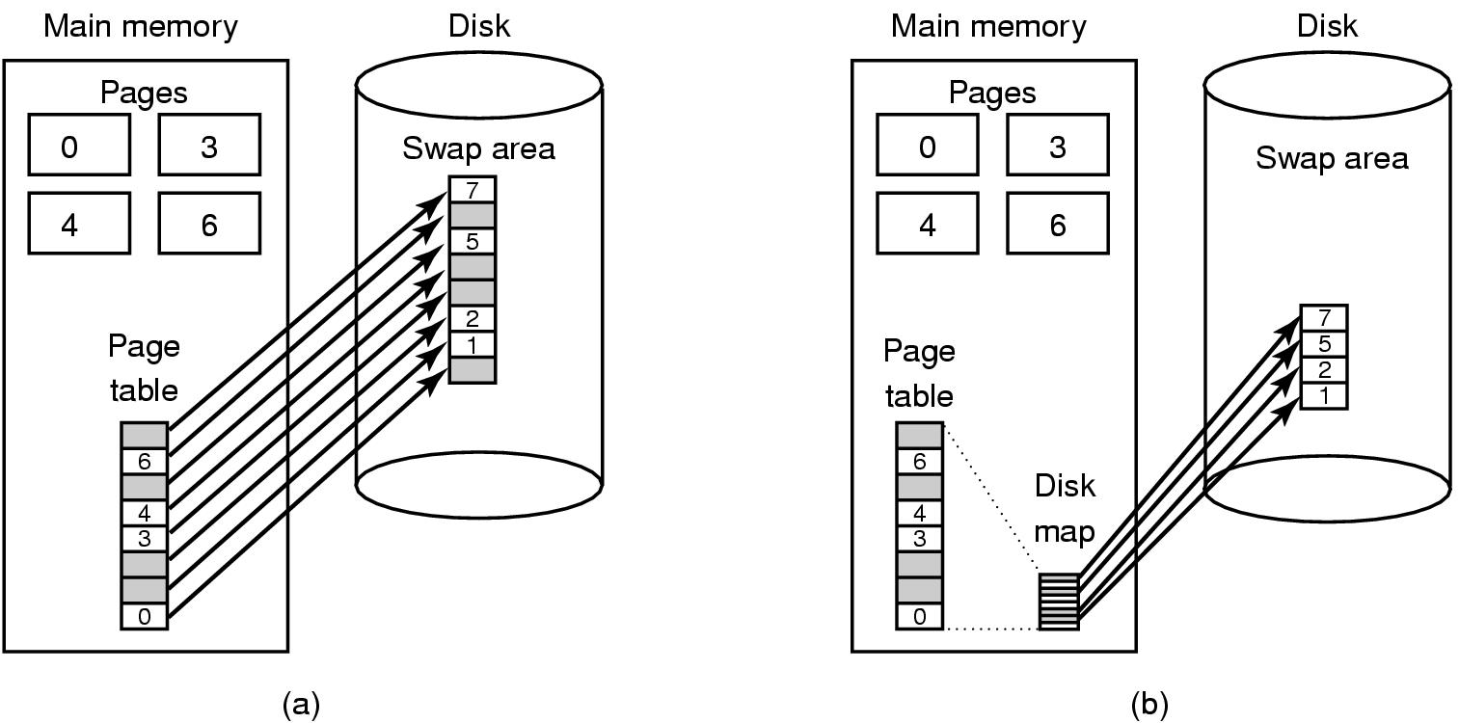
Backing Store
Paging to a static swap area.
Backing up pages dynamically

Slide 86
Segmentation (1)
A compiler has many tables that are built up as compilation proceeds, possibly including:
The source text being saved for the printed listing (on batch systems).
The symbol table – the names and attributes of variables.
The table containing integer, floating-point constants used.
The parse tree, the syntactic analysis of the program.
The stack used for procedure calls within the compiler.

Slide 87

Segmentation (2)
In a one-dimensional address space with growing tables, one table may bump into another.

Slide 88
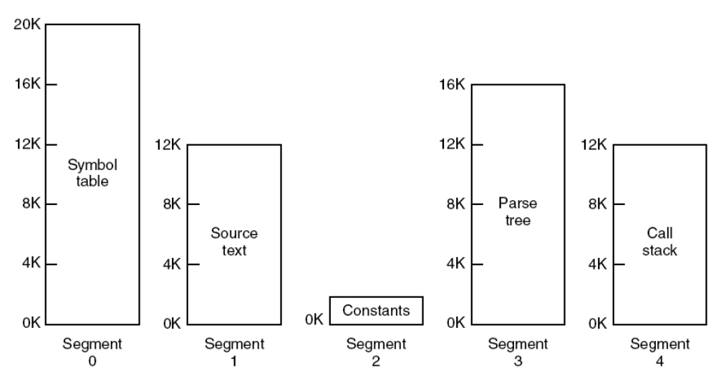
Segmentation (3)
A segmented memory allows each table to grow or shrink independently of the other tables.

Slide 90

Implementation of Pure Segmentation
Comparison of paging and segmentation.

Slide 91
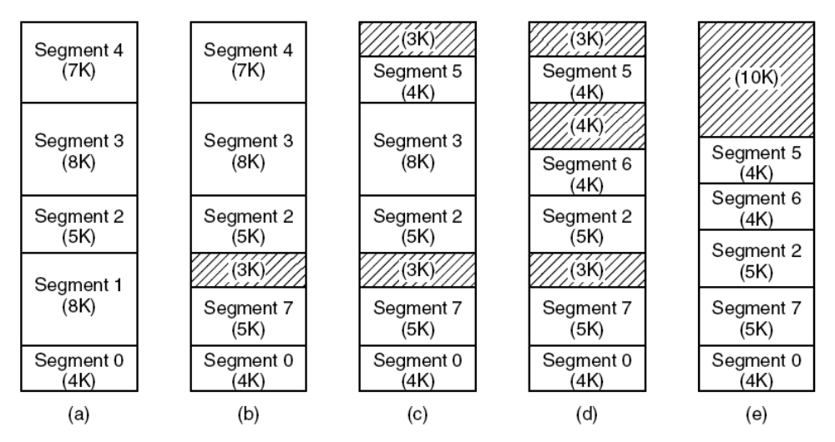
Segmentation
(a)-(d) Development of checkerboarding. (e) Removal of the checkerboarding by compaction.

Slide 92
Segmentation with Paging: MULTICS

Slide 93
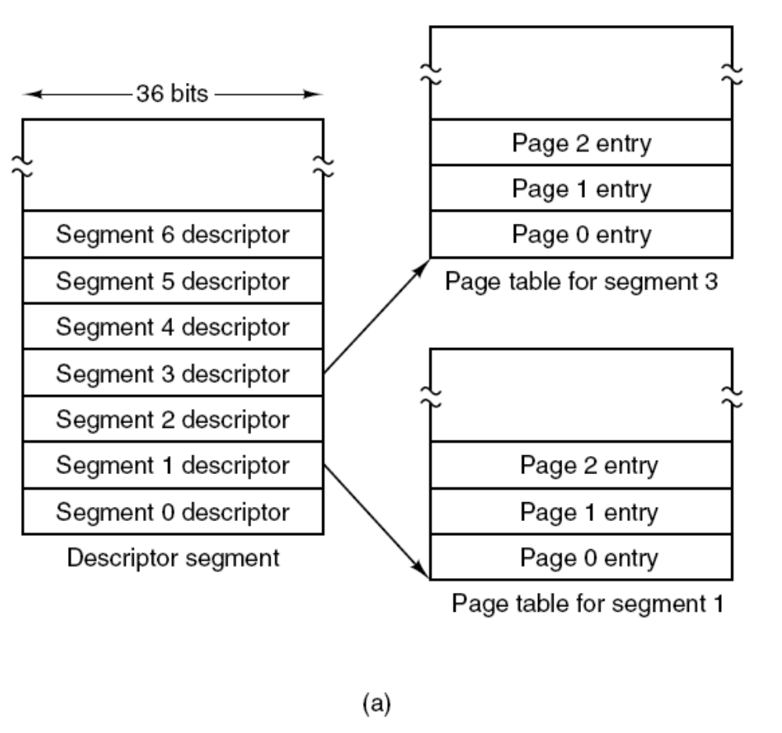
Segmentation with Paging: MULTICS (2)
The MULTICS virtual memory. (a) The descriptor segment points to the page tables.

Slide 94
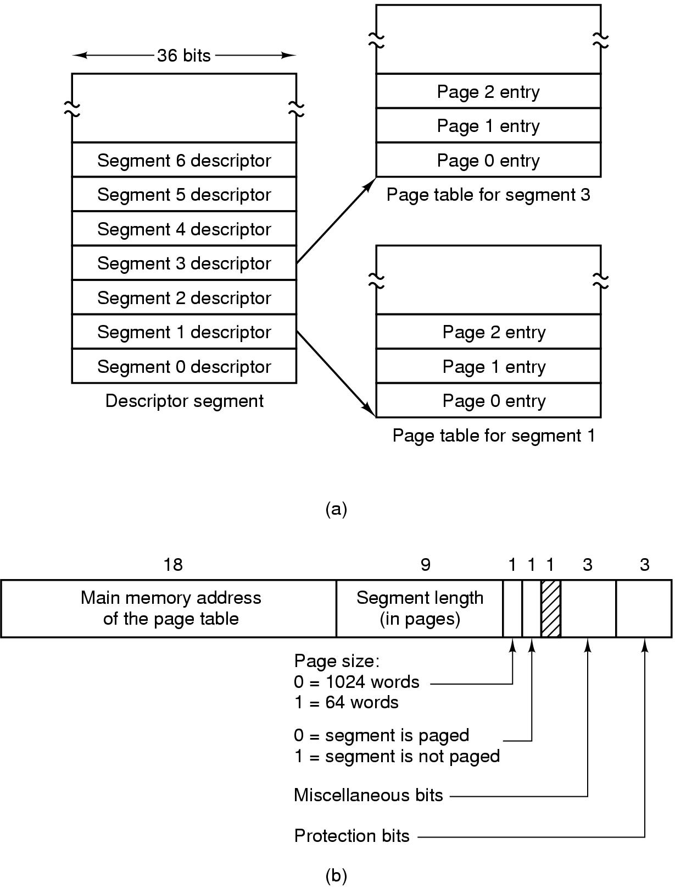
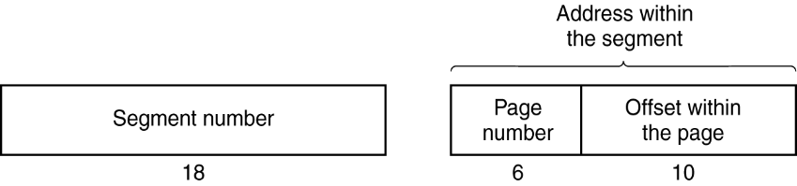
Segmentation with Paging: MULTICS (5)
Virtual memory of up to 2^18 segments
Each segment up to 65,536 words long (2^16)
Each word 36 bit
Each MULTCIS program has –
One segment table, one descriptor/segment
Segment table itself is paged
Descriptor contains 18 bit pointer to its page table
Need another table to save the addresses of the segments
in the secondary memory (e.g., disk), which is used by
the segment fault handler
Page size 1024 words
Address contained two parts – the segment + the address
within the segment
The address within the segment has two parts – page number +
word within the page
The MULTICS virtual memory.
(b) A segment descriptor. The numbers are the field lengths.
A 34-bit MULTICS virtual address.

Slide 95
Segmentation with Paging: MULTICS (6)
When a memory reference occurs, the following algorithm is carried out:
The descriptor base register used to locate the descriptor segment’s page table
The segment number used to find segment descriptor.
Check is made to see if the segment’s page table is in memory.
  If not, segment fault occurs.
  If there is a protection violation, a fault (trap) occurs.
Page table entry for the requested virtual page examined.
  If the page itself is not in memory, a page fault is triggered.
  If it is in memory, the main memory address of the start of the page is extracted from the page table entry
The offset is added to the page origin to give the main memory address where the word is located.
The read or store finally takes place.

Slide 97
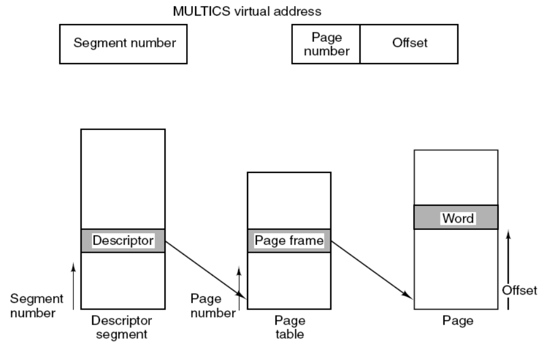
Segmentation with Paging: MULTICS (9)
Conversion of a two-part MULTICS address into a main memory address.

Slide 98
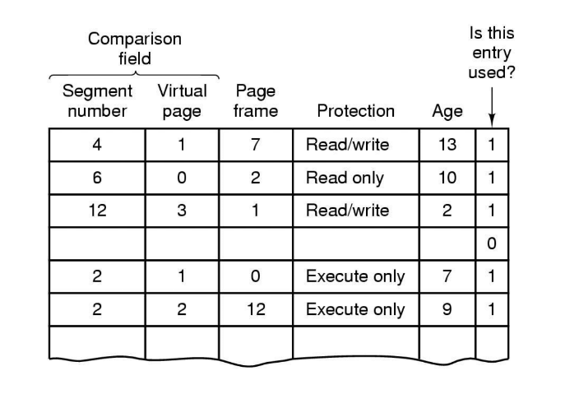
A simplified version of the MULTICS TLB.
Addresses of 16 most recent referenced pages kept in the TLB

Slide 100
Segmentation with Paging: The Pentium

Slide 101
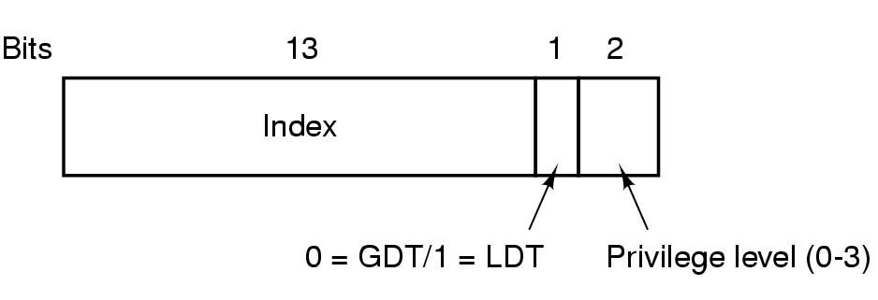
Segmentation with Paging: The Pentium
Multics – 256K segments, each up to 64K 36-bit words
Intel x86 – 16K segments, each up to 1 billion 32-bit words
X86-64 – segmentation is considered obsolete, except in legacy mode
A Pentium selector.
- Each program has its own LDT
Only one GDT – for systems/OS
LDT/GDT can hold upto 8K segment descriptors (2^13)
Descriptor 0 is forbidden
Selector 72 => 0000 0000 0100 1000 => Entry 9 in GDT,
which is located at address GDT+72

Slide 102
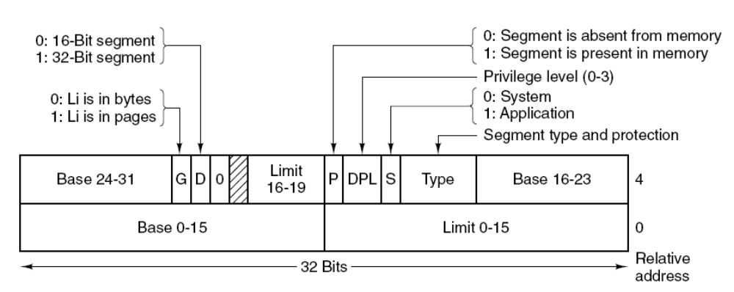
Segmentation with Paging: The Pentium
Pentium code segment descriptor. Data segments differ slightly.

Slide 103
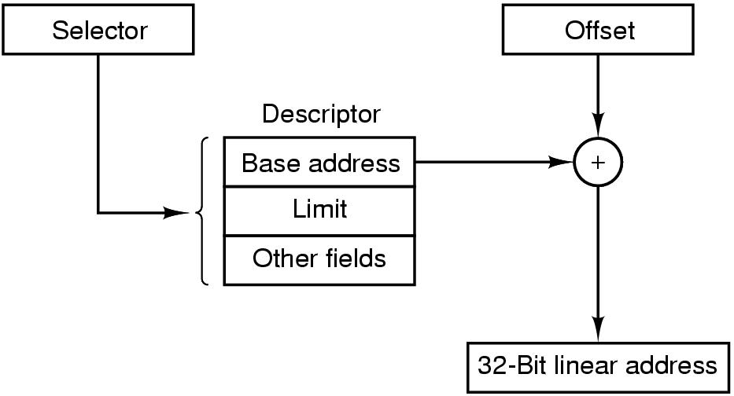
Segmentation with Paging: The Pentium
Address in the form of (Selector, offset) pair
(selector, offset) pair => selector is used to look up the segment descriptor
Base address from the descriptor is added to the offset => linear address
If paging is disabled, linear address is physical address
Otherwise, linear address is interpreted as virtual address, and needs to be converted.
Conversion shown in the next page.
Conversion of a (selector, offset) pair to a linear address.

Slide 104
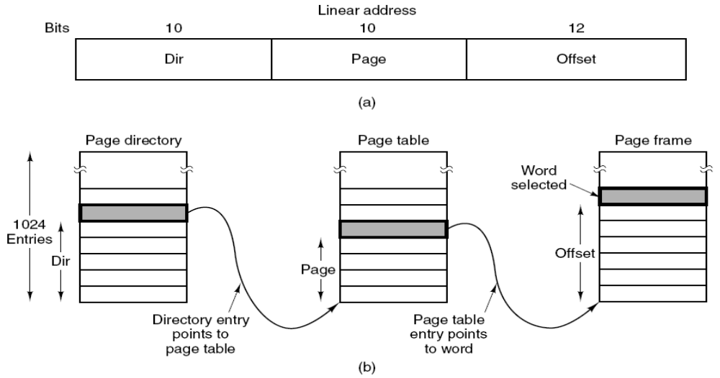
Segmentation with Paging: The Pentium
Mapping of a virtual linear address onto a physical address.
What is a program does not need segmentation?
Set all segment register with the same selector, base=0, limit=maximum
Leads to just one address space

